Slide 1
Optimization : Tutorial-1
Abhishek Rishabh
March 2021
ISB

Slide 2
Contents for Today
Model Formulation and Graphical solution
  Maximization
  Minimization
Excel model setup, solving and interpretation
Transportation Problem

Slide 3
Model Formulation

Slide 4
Exercise 1
The Apex Television Company has to decide on the number of 27- and 20-inch sets to be produced at one of its factories. Market research indicates that at most 40 of the 27-inch sets and 10 of the 20-inch sets can be sold per month. The maximum number of work-hours available is 500 per month. A 27-inch set requires 20 work-hours and a 20-inch set requires 10 work-hours. Each 27-inch set sold produces a profit of $120 and each 20-inch set produces a profit of $80. A wholesaler has agreed to purchase all the television sets produced if the numbers do not exceed the maxima indicated by the market research.
(a) Formulate a linear programming model for this problem.
(b) Use the graphical method to solve this model.

Slide 5
Exercise 1- solution
X1 = no of 27 inch TVs
X2 = no of 20 inch TVs
Obj function Max Z= 120*X1 + 80*X2
X1<=40 and X2<=10
20*X1+10*X2<=500 ; X1>=0, X2>=0

Slide 6
Exercise 1- solution
20*X1+10*X2<=500
X1/25+x2/50=1
x2
50
0,10,800
20,10,3200
10
FS
25,0,3000
0,0,0
25
40
x1

Slide 7
Exercise 2
Dwight is an elementary school teacher who also raises pigs for supplemental income. He is trying to decide what to feed his pigs. He is considering using a combination of pig feeds available from local suppliers. He would like to feed the pigs at minimum cost while also making sure each pig receives an adequate supply of calories and vitamins. The cost, calorie content, and vitamin content of each feed are given in the table below.
Each pig requires at least 8,000 calories per day and at least 700 units of vitamins. A further constraint is that no more than one-third of the diet (by weight) can consist of Feed Type A, since it contains an ingredient which is toxic if consumed in too large a quantity.
(a) Formulate a linear programming model for this problem.
(b) Use the graphical method to solve this model. What is the resulting daily cost per pig?
Contents | Feed Type A | Feed Type B
Calories (per pound) | 800 | 1,000
Vitamins (per pound) | 140 units | 70 units
Cost (per pound) | $0.40 | $0.80

Slide 8
Exercise 2- solution
A = qty of feed A
B = qty of feed B
Obj fn Min Z=0.4*A+0.8*B
800*A+1000*B>=8000
140*A+70*B>=700
A<=1/3(A+B) =>2A/3-B/3<=0
A>=0, B>=0

Slide 9
Exercise 2- solution
B
FS
140*A+70*B>=700
0,10,8
800*A+1000*B>=8000
0,8
Z=0.4*A+0.8*B
5/3,20/3
20/7,40/7,5.71
At 3 points we have values as
8,6,5.71
Therefore the optimal value is
5.71 @ (20/7,40/7)
5,0
10,0
A

Slide 10




Exercise 2- solution
B
FS
140*A+70*B>=700
0,10,8
800*A+1000*B>=8000
0,8
Z=0.4*A+0.8*B
5/3,20/3
20/7,40/7,5.71
At 3 points we have values as
8,6,5.71
Therefore the optimal value is
5.71 @ (20/7,40/7)
5,0
10,0
A

Slide 11
Excel Exercise

Slide 12
Excel Exercise Interpretation
Use excel to solve the following.
Max 50A + 60B + 55C
s.t. A + B + C ≤ 100
2A + 3B + 2C ≤ 300
2A + 3B + 2C ≥ 250
A + 2C ≥ 60

Slide 13
Excel Exercise Interpretation
State the optimal solution
What is the optimal objective function value?
What would happen to the optimal solution if a) the unit profit on B decreases by 20? b) the unit profit on C decreases to 45? c) the unit profits on A & C change to 53 (Simultaneous Changes-100% Rule)?
Interpret the reduced cost for A
What would happen to the objective function if a) the RHS of constraint 1 increases by 5? b) the RHS of constraint 2 decreases to 250? c) the RHS of constraint 4 changes to 44?
Which constraints are binding?
What are the slack/surplus values?

Slide 14
Excel Exercise Interpretation
State the optimal solution
Variable Cells
 |  |  | Final | Reduced | Objective | Allowable | Allowable
 | Cell | Name | Value | Cost | Coefficient | Increase | Decrease
 | $B$6 | Number to make A | 0 | -7.5 | 50 | 7.5 | 1E+30
 | $C$6 | Number to make B | 70 | 0 | 60 | 1E+30 | 5
 | $D$6 | Number to make C | 30 | 0 | 55 | 5 | 15

Slide 15
Excel Exercise Interpretation
What would happen to the optimal solution if a) the unit profit on B decreases by 20?
Upper limit for B is Inf, lower limit 65
Current coef=60, decreased coef =60-20=40 => 40<55 => optimal solution will change.
Variable Cells
 |  |  | Final | Reduced | Objective | Allowable | Allowable
 | Cell | Name | Value | Cost | Coefficient | Increase | Decrease
 | $B$6 | Number to make A | 0 | -7.5 | 50 | 7.5 | 1E+30
 | $C$6 | Number to make B | 70 | 0 | 60 | 1E+30 | 5
 | $D$6 | Number to make C | 30 | 0 | 55 | 5 | 15

Slide 16
Excel Exercise Interpretation
What would happen to the optimal solution if a ) the unit profit on C decreases to 45?
Upper limit for C is 60, lower limit 40
Current coef=55, decreased coef =45 => 40<45<60 < => optimal solution will NOT change.
Variable Cells
 |  |  | Final | Reduced | Objective | Allowable | Allowable
 | Cell | Name | Value | Cost | Coefficient | Increase | Decrease
 | $B$6 | Number to make A | 0 | -7.5 | 50 | 7.5 | 1E+30
 | $C$6 | Number to make B | 70 | 0 | 60 | 1E+30 | 5
 | $D$6 | Number to make C | 30 | 0 | 55 | 5 | 15

Slide 17

Excel Exercise Interpretation
What would happen to the optimal solution if a the unit profits on A & C change to 53 ?
$∑\left(\frac{Proposed}{Allowed}\right)<100\%$ => optimal soln doesn’t change.
-Inf<A<57.5 and 40<C<60 => For A (53-50)/7.5=3/7.5=0.4
For C (55-53)/15=0.133 ; Sum of ration 0.4+0.133 <100% => optimal soln does not change.
Variable Cells
 |  |  | Final | Reduced | Objective | Allowable | Allowable
 | Cell | Name | Value | Cost | Coefficient | Increase | Decrease
 | $B$6 | Number to make A | 0 | -7.5 | 50 | 7.5 | 1E+30
 | $C$6 | Number to make B | 70 | 0 | 60 | 1E+30 | 5
 | $D$6 | Number to make C | 30 | 0 | 55 | 5 | 15

Slide 18
Excel Exercise Interpretation
Interpret the reduced cost for A
Amount by which profit will be reduced if we include 1 unit of A.
Variable Cells
 |  |  | Final | Reduced | Objective | Allowable | Allowable
 | Cell | Name | Value | Cost | Coefficient | Increase | Decrease
 | $B$6 | Number to make A | 0 | -7.5 | 50 | 7.5 | 1E+30
 | $C$6 | Number to make B | 70 | 0 | 60 | 1E+30 | 5
 | $D$6 | Number to make C | 30 | 0 | 55 | 5 | 15

Slide 19
Excel Exercise Interpretation
See constraint 1.
Shadow price remains unchanged for constraint for the RHS range of 100-6.667 and 100+10
Shadow price means – change in optimal profit per unit increase in RHS of that constraint.
What if RHS of constraint 1 is changed by 5?
Within allowable region. (Why?) Therefore the profit changes by 5*60=300. New profit -> 5850+300=6150.
Constraints
 |  |  | Final | Shadow | Constraint | Allowable | Allowable
 | Cell | Name | Value | Price | R.H. Side | Increase | Decrease
 | $E$11 | Constraint 3 Used | 270 | 0 | 250 | 20 | 1E+30
 | $E$12 | Constraint 4 Used | 60 | -2.5 | 60 | 40 | 60
 | $E$9 | Constraint 1 Used | 100 | 60 | 100 | 10 | 6.666666667
 | $E$10 | Constraint 2 Used | 270 | 0 | 300 | 1E+30 | 30

Slide 20
Excel Exercise Interpretation
See constraint 2.
What if RHS of constraint 2 decreases to 250?
Proposed decrease 300-250=50. Outside allowable zone.
We can’t say anything. We need to resolve the model.
Constraints
 |  |  | Final | Shadow | Constraint | Allowable | Allowable
 | Cell | Name | Value | Price | R.H. Side | Increase | Decrease
 | $E$11 | Constraint 3 Used | 270 | 0 | 250 | 20 | 1E+30
 | $E$12 | Constraint 4 Used | 60 | -2.5 | 60 | 40 | 60
 | $E$9 | Constraint 1 Used | 100 | 60 | 100 | 10 | 6.666666667
 | $E$10 | Constraint 2 Used | 270 | 0 | 300 | 1E+30 | 30

Slide 21
Excel Exercise Interpretation
See constraint 4.
What if RHS of constraint 4 changes to 44?
Proposed decrease 60-44=16. inside allowable zone. (Why?)
Shadow price can be used => -16*-2.5=40=> profit increases by 40.
Constraints
 |  |  | Final | Shadow | Constraint | Allowable | Allowable
 | Cell | Name | Value | Price | R.H. Side | Increase | Decrease
 | $E$11 | Constraint 3 Used | 270 | 0 | 250 | 20 | 1E+30
 | $E$12 | Constraint 4 Used | 60 | -2.5 | 60 | 40 | 60
 | $E$9 | Constraint 1 Used | 100 | 60 | 100 | 10 | 6.666666667
 | $E$10 | Constraint 2 Used | 270 | 0 | 300 | 1E+30 | 30

Slide 22
Excel Exercise Interpretation
Binding vs Non Binding Constraints
Constraints
 |  |  | Final | Shadow | Constraint | Allowable | Allowable
 | Cell | Name | Value | Price | R.H. Side | Increase | Decrease
 | $E$11 | Constraint 3 Used | 270 | 0 | 250 | 20 | 1E+30
 | $E$12 | Constraint 4 Used | 60 | -2.5 | 60 | 40 | 60
 | $E$9 | Constraint 1 Used | 100 | 60 | 100 | 10 | 6.666666667
 | $E$10 | Constraint 2 Used | 270 | 0 | 300 | 1E+30 | 30

Slide 23
Transportation Problem
The transportation problem seeks to minimize the total shipping costs of transporting goods from m origins or sources (each with a supply s_{i}) to n destinations (each with a demand d_{j}), when the unit shipping cost from source, i, to a destination, j, is c_{ij}.

Slide 24
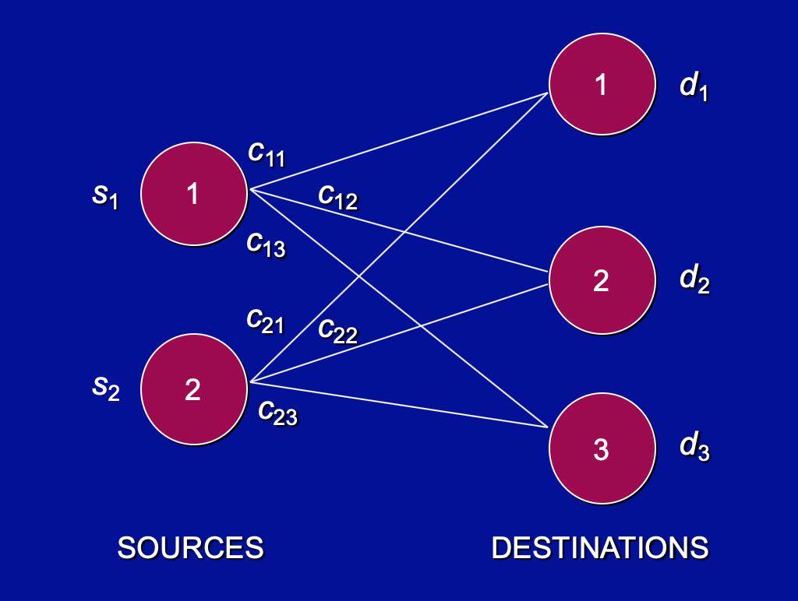
Transportation Problem – Network Representation

Slide 25
Transportation Problem – Example 1
Let England, France, and Spain be the three sources, where their supplies are the millions of acres of land that are available for growing these crops. Let Wales, Brighton, and Oakley be the three destinations, where their demands are the millions of acres of land that are needed to fulfill the world demand for these respective crops. The unit cost (in millions of dollars) is the labor cost per million acres, so the number of hours of labor needed is multiplied by the cost per hour. The parameter table is as follows.

Slide 26
Transportation Problem – Example 1
 |  | Unit Cost ($ million)
 |  |  | Destination
 |  | Wales | Brighton | Oakley | Supply
 | England | 162 | 121.5 | 82.8 | 70
Source | France | 93.6 | 108 | 75 | 110
 | Spain | 158.4 | 100.8 | 100.8 | 80
Demand |  | 125 | 60 | 75

Slide 27
Transportation Problem – Example 1
Draw the network representation.
Formulate it as a LP.

Slide 28
Transportation Problem – Example 2
Apple wants to manufacture iPhone locally in India. Apple launched four manufacturing facilities in India recently. F1, F2, F3 and F4 respectively. Also, Apple recognized Mumbai, Delhi, Hyderabad and Bangalore as its main markets. Below is a table which gives the transportation costs. Find out which factory should send how many iPhones to each market so that the total cost is minimal? Remember demand in each market should be met.

Slide 29
Transportation Problem – Example 2
 | Mumbai | Delhi | Hyderabad | Bangalore | Capacity
F1 | 50 | 40 | 60 | 30 | 2500
F2 | 70 | 80 | 80 | 10 | 3000
F3 | 40 | 40 | 30 | 60 | 1000
F4 | 80 | 70 | 60 | 80 | 2000
Demand | 2500 | 2000 | 2000 | 2000

Slide 30
Transportation Problem – Example 2
Draw the network representation
Formulate it as LP
Solve it using excel

Slide 31
Duality

Slide 32
Exercise 1
Construct the dual problem for the following linear programming model fitting our standard form.
Min Z = 2*x2+5*x3
X1+x2>=2
2x1+x2+6x3<=6
X1-x2+3x3=4
X1,x2,x3>=0
DUAL
Max Z1=0*X1-2x2-5x3
-x1-x2<=-2
2x1+x2+6x3<=6
X1-x2+3x3<=4
-X1+x2-3x3<=-4
X1,x2,x3>=0
Min z2=-2w1+6w2+4w3-4w4
-w1+2w2+w3-w4>=0
-w1+w2-w3+w4>=-2
6w2+3w3-3w4>=-5

Slide 33
Exercise 2
X=y is same as saying { x>=y and y>=x}
Construct the dual problem for the following linear programming model fitting our standard form.
Max Z = 2*x1+3*x2+x3
4x1+3x2+x3=6
X1+2x2+5x3=4
X1,x2,x3>=0
DUAL
Max Z= 2*x1+3*x2+x3
-4x1-3x2-x3<=-6
4x1+3x2+x3<=6
-X1-2x2-5x3<=-4
X1+2x2+5x3<=4
Min -6w1+6w2-4w3+4w4
-4w1+4w2-w3+w4>=2
-3w1+3w2-2w3+2w4>=3
-w1+w2-5w3+5w4>=1

